Slide 1

PIMPRI CHINCHWAD EDUCATION TRUST’S PIMPRI CHINCHWAD COLLEGE OF ENGINEERING SECTOR NO. 26, PRADHIKARAN, NIGDI, PUNE- 411044.
Project Topic: Image Processing Based Semi - Automated Target Detector and Shooter
Project ID:- A-16 Project Group Members:
Sr. No | Name | Roll No.
1. | Aniket Sudhakar Chopade | BEETA121
2. | Swapnil Nileshrao Dasarwar | BEETA123
3. | Raviraj Mahadeo Khopade | BEETA146
Mr. M. M. Narkhede | Prof. A. B. Patil | Dr. M. T. Kolte
Project Guide | Project Coordinator | HoD (EnTC)
DEPARTMENT OF ELECTRONICS & TELECOMMUNICATION B.E. (E&TC) 2020-2021

Slide 2
CONTENTS
Introduction
Robots used in Defense
Problem Statement
Necessity
Objectives
Components
Softwares used
Block Diagram
System Flow Chart
Target Detection Flow Char
Yolov4-tiny
Object Detector Model Training Results
Conclusion

Slide 3
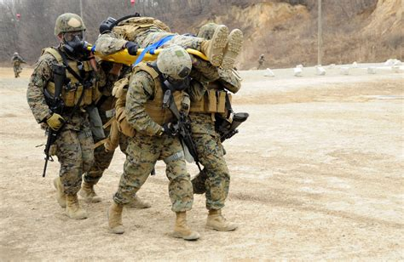
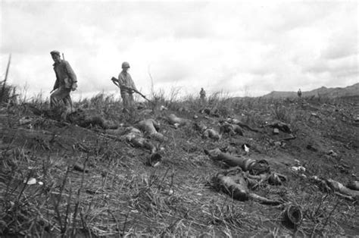
INTRODUCTION
Threats to India from neighbouring countries.
Human casualties & defence improvisation.
Robots and why we need them?
Basic idea of semi-automatic defence system.

Slide 4
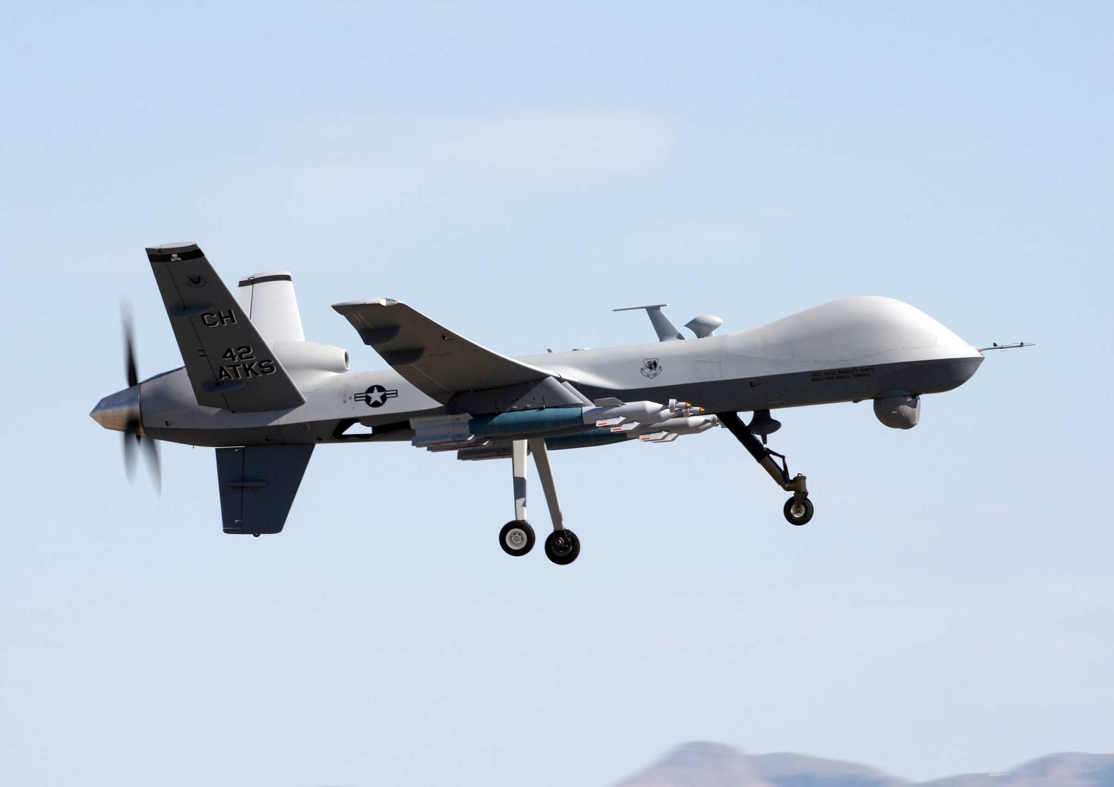
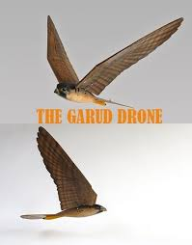
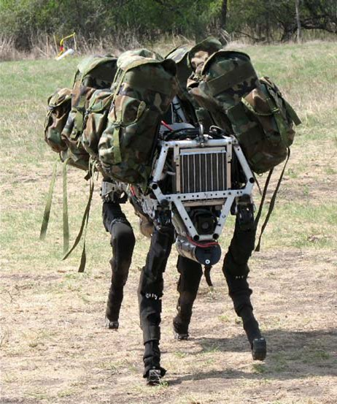
ROBOTS USED IN DEFENSE
Combat Drone
used for intelligence, surveillance, target acquisition, and carries aircraft ordnance
Garud Drone A drone used to spy
Big Dog
a quadruped robot, was being
developed as a mule that can
traverse difficult terrain.

Slide 5
PLEDGE
Thousands of scientists and engineers pledge not to help build killer robots
“ We the undersigned agree that the decision to take a human life should never be delegated to a machine. There is a moral component to this position, that we should not allow machines to make life-taking decisions for which others – or nobody – will be culpable”

Slide 6
PROBLEM STATEMENT
To design an integrated Computer Vision based semi-automated system which captures real time video input and processes it to detect specific object and shoot it.

Slide 7
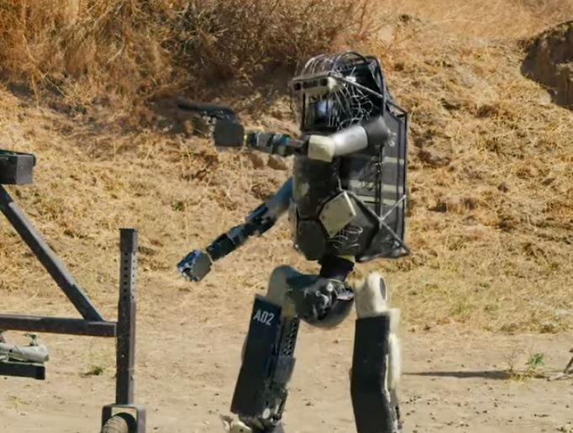
NECESSITY
Self defence in 21st century.
Reduce human casualties on borders.
Need to improve defence by introducing robotic systems.
Systems which can be operating automatically or operated by
humans remotely.

Slide 8
OBJECTIVES
Proposed system should be able to detect particular specified object/target by the help of video processing algorithm.
After detection of object/target system controller should be able to shoot at that particular object.
The shooting mechanism which helps the controller gain maximum accuracy for hitting the target.
Proposed system consists of wireless communication which provide a long-range contactless operability to user.
System can replace Humans on the battlefield and therefore helps in reducing the human casualties on borders.

Slide 9
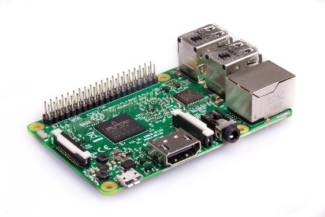
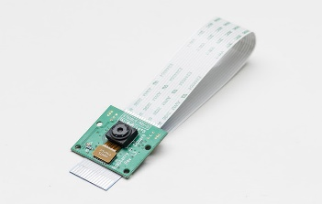
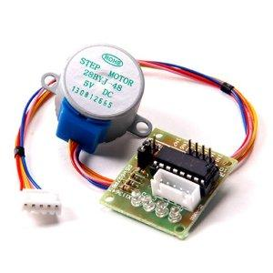
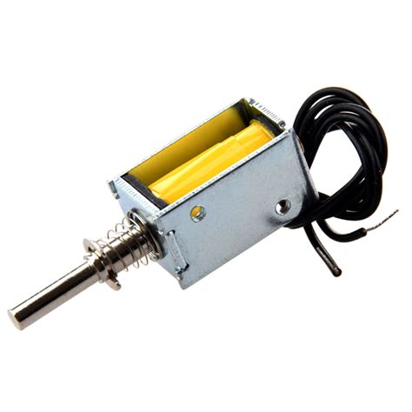
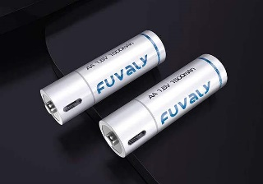
COMPONENTS
Raspberry pi 4 B
Pi cam
Stepper motor & DC motors
Driver IC’s (ULN2003, L293D)
Push Pull Solenoid
Lithium ion batteries

Slide 10




SOFTWARES USED
Python 3
Visual Studio Code
Anaconda Libraries
Google Colab

Slide 11
BLOCK DIAGRAM
Power Supply
Solenoid
Pi Camera
Raspberry pi 4B
Motors
Display

Slide 12
SYSTEM FLOW CHART
START
Take manual movement controls
Keep Tracing Target
No
Target Found ?
Yes
Align target to center of screen
No
Target Centered ?
Yes
Solenoid actuation
END

Slide 13
TARGET DETECTION FLOW CHART
START
Input Video
Model Loading
Prediction
Prediction Threshold
Bounding Boxes
Output
END

Slide 14
Why YOLOv4 tiny ?
One stage Detection Model
Compressed Version of YOLOv4
Consists of 29 pretrained CNN layered architecture
Neck (SPP) removes the fixed size constraint
10% more meanAP YOLOv3
8 times FPS Support than YOLOv4

Slide 15
Why YOLOv4 tiny ?
5/2 times FPS Support for proposed model
Computational Complexity CSPBlock to ResBlock-D is 10:1
Complexity ratio for proposed model is 4:1
Train 350 images in 1 hour when using a Tesla P100 GPU
For our model - approx 1 hour and for Yolov4 model - 3-4 hours (6000 iterations) Tesla T4 CPU
YOLOv4-tiny has an inference speed of 3 ms on the Tesla P100, making it one of the fastest object detection models to exist.

Slide 16
YOLOv4 vs YOLOv4-tiny
YOLOv4 | YOLOv4-tiny
Works better with Images | Works better with Video
Low FPS support (upto 55 FPS ) | High FPS support ( upto 155 FPS )
More time complexity. | Less time complexity.
More space complexity. | Less space complexity.
Training average loss : 0.314525 | Training average loss : 0.012734

Slide 17
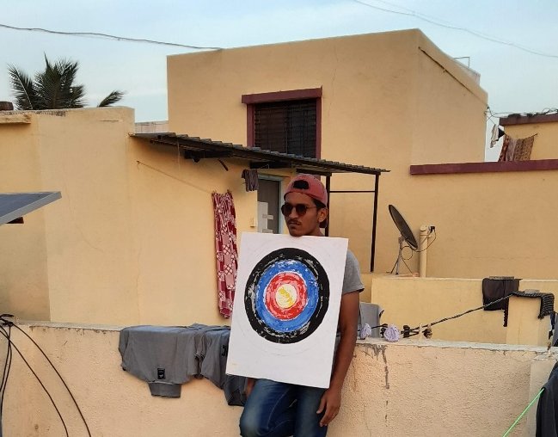
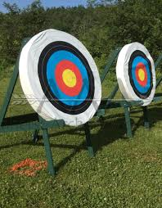
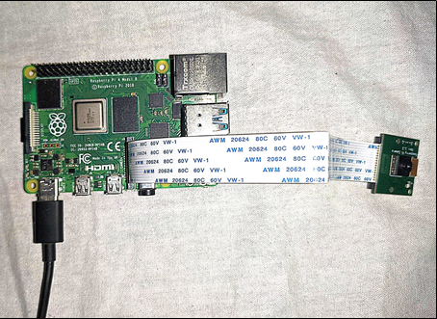
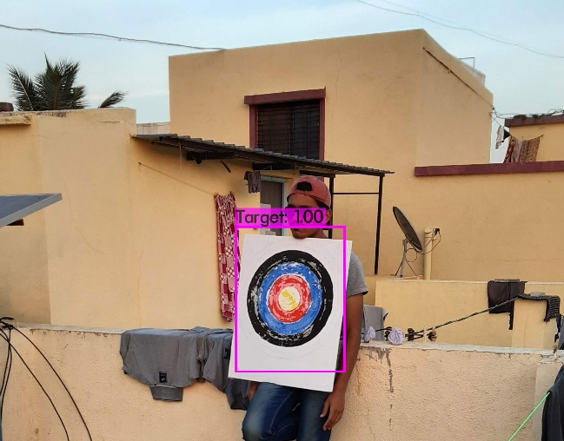
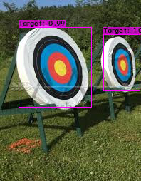
Object Detector Model Training Results
Image 1
Image 2

Slide 18
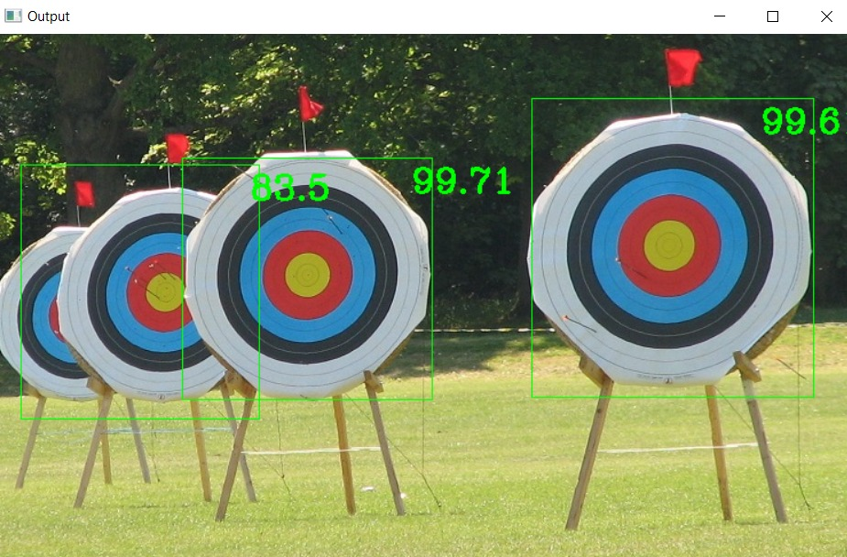
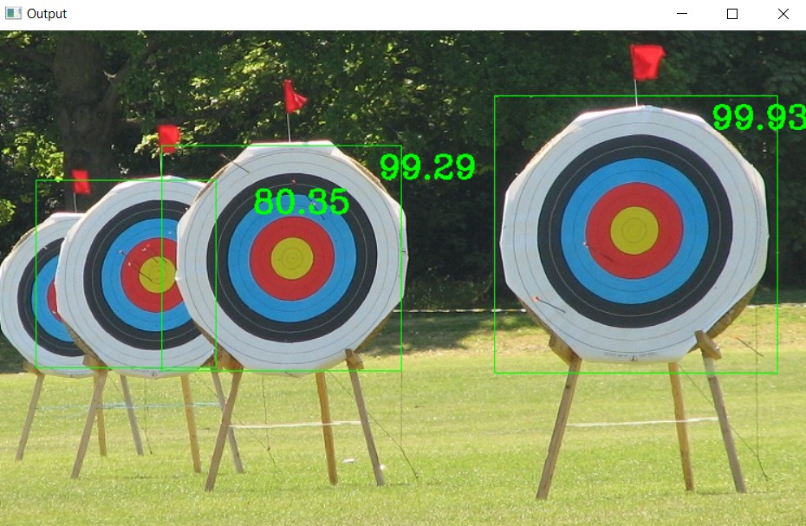
COMPARISON BASED ON SIMULATION
YOLOv4
YOLOv4 - tiny
> YOLOv4 Average Precision: 94.27
> YOLOv4-Tiny Average Precision: 93.90
> Impact on average precision: ~0.5%
Image Source : Google Images

Slide 19
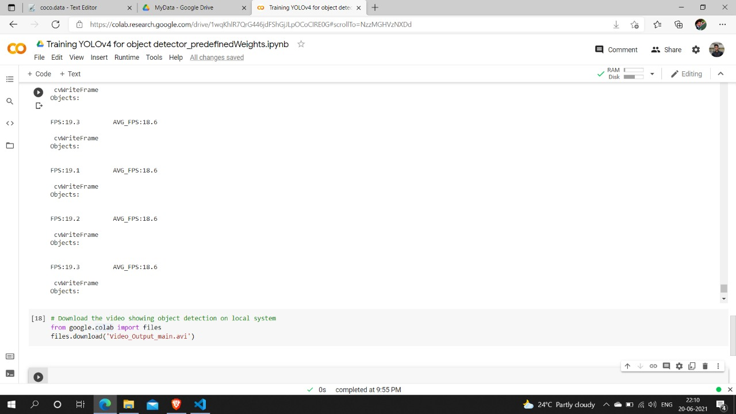
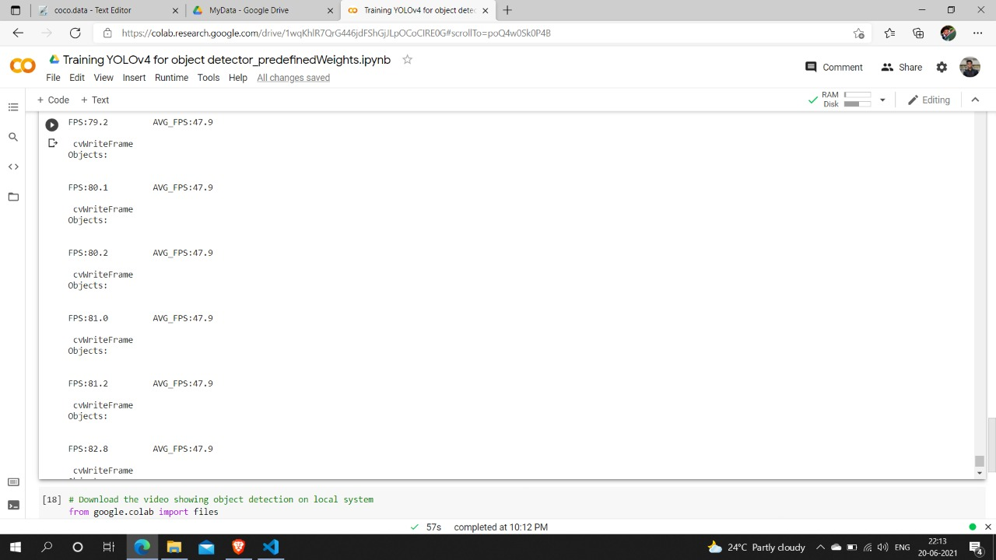
COMPARISON BASED ON SIMULATION
YOLOv4 ( FPS )
YOLOv4 - tiny ( FPS )

Slide 20

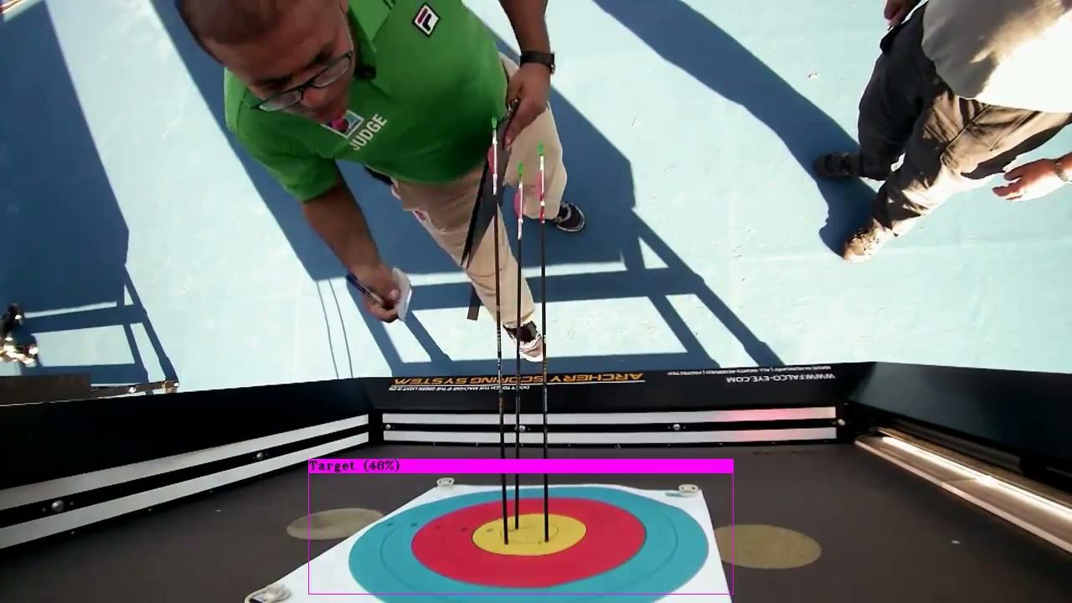
YOLOv4
YOLOv4 - tiny
Video Source : Internet

Slide 21
CONCLUSION
The project plans to propose a system which would detect specific target objects with the help of video processing algorithm. Once the target object is detected, system controller shoots aiming at the same targeted object. Maximum accuracy is achieved by using solenoid based subsystem. This proposed system consisting of wireless communication provides long range contactless operability to the users. Hence ,this system in future can replace human- beings and therefore help in reducing human casualties on the border.

Slide 22
REFERENCES
[1] G. Chandan, A. Jain, H. Jain and Mohana, "Real Time Object Detection and Tracking Using Deep Learning and OpenCV," 2018 International Conference on Inventive Research in Computing Applications (ICIRCA), 2018, pp. 1305-1308, doi: 10.1109/ICIRCA.2018.8597266.
[2] J. Redmon, S. Divvala, R. Girshick and A. Farhadi, "You Only Look Once: Unified, Real-Time Object Detection," 2016 IEEE Conference on Computer Vision and Pattern Recognition (CVPR), 2016, pp. 779-788, doi: 10.1109/CVPR.2016.91.
[3] A. M. Ghoreyshi, A. Akhavan Pour and A. Bossaghzadeh, "Simultaneous Vehicle Detection and Classification Model based on Deep YOLO Networks," 2020 International Conference on Machine Vision and Image Processing (MVIP), 2020, pp. 1-6, doi: 10.1109/MVIP49855.2020.9116922.
[4] Y. Wang, L. Wang, Y. Jiang and T. Li, "Detection of Self-Build Data Set Based on YOLOv4 Network," 2020 IEEE 3rd International Conference on Information Systems and Computer Aided Education (ICISCAE), 2020, pp. 640-642, doi: 10.1109/ICISCAE51034.2020.9236808.

Slide 23
THANK YOU

